Slide 1






Human Issues/Problems/Challenges
Technological Solutions

Slide 2
Introduction
In today's fast-paced and linked world, humanity faces a variety of urgent difficulties and challenges. In this discussion, we will explore at some of the most critical human issues and problems that require immediate attention and coordinated efforts to resolve.

Slide 3

Food Insecurity and Malnutrition

Slide 4
Precision Agriculture and Vertical Farming
Technological Solution

Slide 5
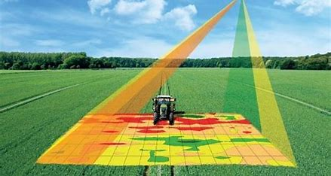
Precision Agriculture
Utilizing advanced technologies such as drones, sensors, and data analytics, precision agriculture optimizes farming practices to maximize crop yields and minimize resource usage.

Slide 6
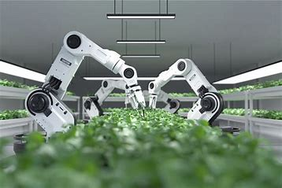
Vertical
Farming
involves growing crops indoors in stacked layers under controlled environments, utilizing hydroponics or aeroponics systems to efficiently produce food in urban areas.

Slide 7
Impacts and Effects
By reducing the need for large land areas and minimizing water usage and pesticide use, precision agriculture and vertical farming contribute to environmental sustainability and conservation.
Vertical farming allows for the cultivation of a wide variety of crops year-round, providing access to fresh and nutrient-dense food, thereby addressing malnutrition.
Precision agriculture techniques improve crop yields and efficiency, ensuring a more reliable food supply to combat food insecurity.

Slide 8
Assistive Technologies for Individuals with Disabilities

Slide 9
Prosthetics and Exoskeletons for Mobility, and Screen Readers for Accessibility
Technological Solution

Slide 10
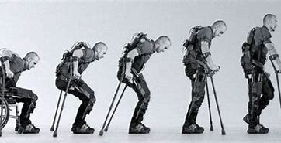
Prosthetics and Exoskeletons
Advanced prosthetic limbs and exoskeletons enhance mobility and independence for individuals with physical disabilities, such as those with broken legs. These devices use sensors and actuators to mimic natural movement and provide support.

Slide 11

Screen Readers and Accessibility Software
Screen readers and accessibility software convert text into speech or braille, enabling individuals with visual impairments, including blindness, to access digital content and navigate electronic devices.

Slide 12
Impacts and Effects
Assistive technologies not only improve physical capabilities but also boost self-esteem and mental well-being by enabling individuals with disabilities to engage more fully in social interactions and activities.
Screen readers and accessibility software empower individuals with visual impairments to access educational materials, work-related documents, and online resources, promoting inclusivity and equal opportunities.
Prosthetics and exoskeletons enable individuals with mobility impairments to perform daily activities, participate in society, and regain independence.

Slide 13

Thank You!
LEADER: Kate Lemarie Cabaya
GROUP MEMBERS
Jhon Lester Tadili ,Antonette Luis
Harold Ronquillo ,Prinz Fariñas
Charles Justin Mamotos ,Denver Areola
Kristle Portuguez ,Mark Pedronan , Nicole ntalan
Joeven Carl ,Jhoana Mae Consejero
Nikk Antalan ,Vaness Rosario

